Slide 1
While Loops
- By
Hemlata Kohin

Slide 2
Today’s Objectives
• To learn about and use a while loop
–To understand the syntax of a while loop
–To use a while loop for interactive loops
–To use a while loop for interactive loops
–To learn about infinite loops
• (And how to avoid them)
• To practice conditionals

Slide 3
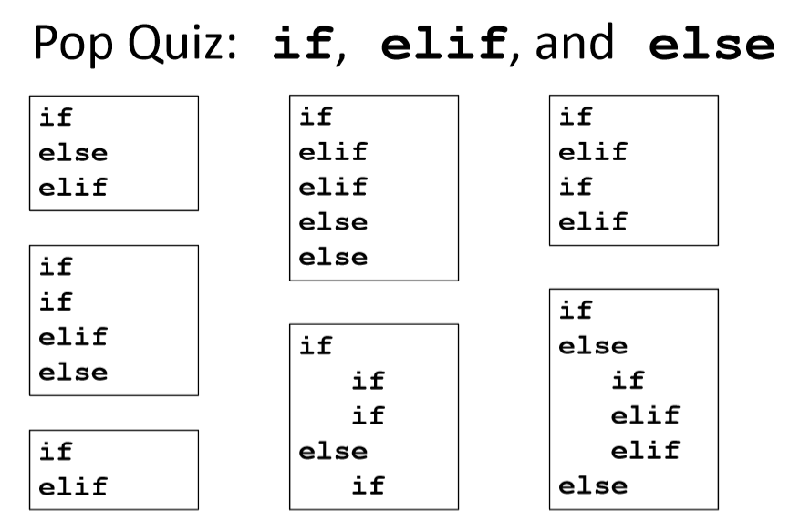

Slide 4
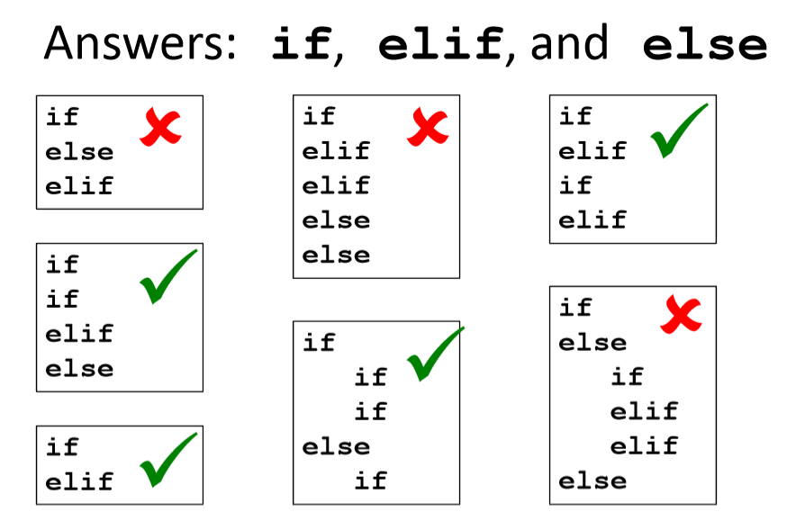

Slide 5
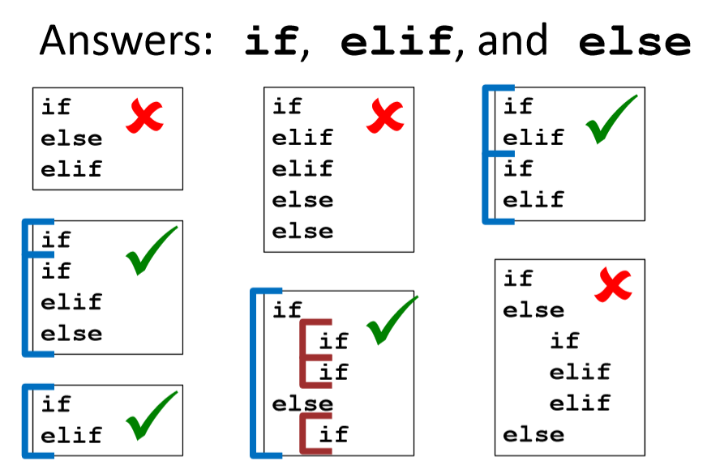

Slide 6
Looping

Slide 7
Looping
• Doing something over and over (and over) again
• Used in combination with decision making
• Used in combination with decision making
–If not decision is being made, we just loop forever
• This is called an “infinite loop”
• What are some real life examples?
–Jumping rope
–Walking up steps

Slide 8
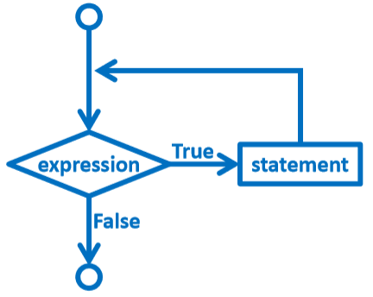
Looping
• It looks something like this…

Slide 9
Looping
• Python has two kinds of loops, and they are used for two different purposes
• The while loop
–Works for basically everything
• The for loop:
–Best at iterating over something
–Best at counted iterations

Slide 10
The while Loop

Slide 11
“while” Loops
• while <condition>:
<body>
• The body is a sequence of one or more statements indented under the heading
–As long as the condition is True, the body will run (repeatedly if
needed)

Slide 12
How a while Loop Works
• The while loop uses a Boolean condition
–That evaluates to either True or False
• If the condition is True:
–Body of while loop is executed
• Once that’s over, condition is checked again
• If the condition is False:
–Body of while loop is skipped

Slide 13
Parts of a while Loop
• Here’s some example code… let’s break it down
date = 0
while date < 1 or date > 30:
date = int(input("Enter the day: "))
print("Today is September", date)

Slide 14
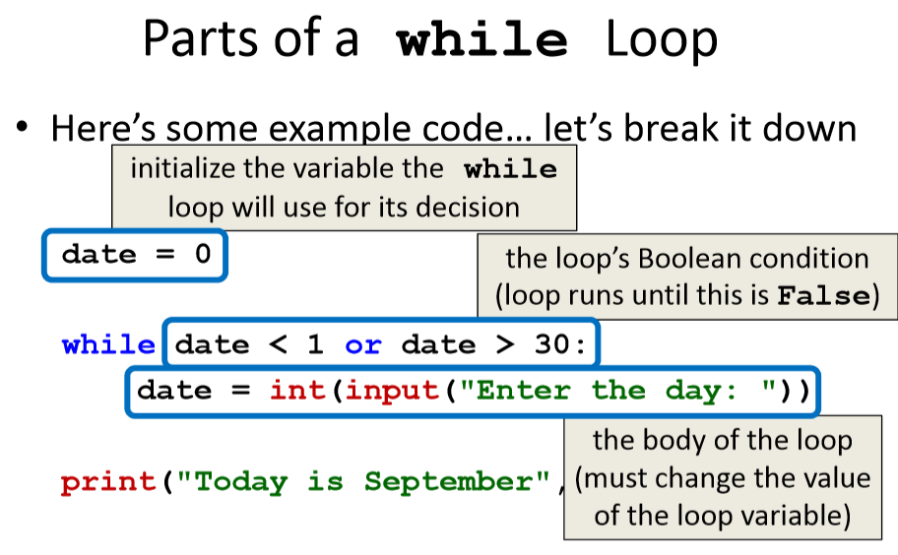

Slide 15
Example while Loop
• We can use a while loop to count
–Count from 1 up to and including 20
num = 1 # we have to initialize num
while num <= 20: # so that we can use it here
print(num)
num = num + 1 # don't forget to update
# the loop variable

Slide 16
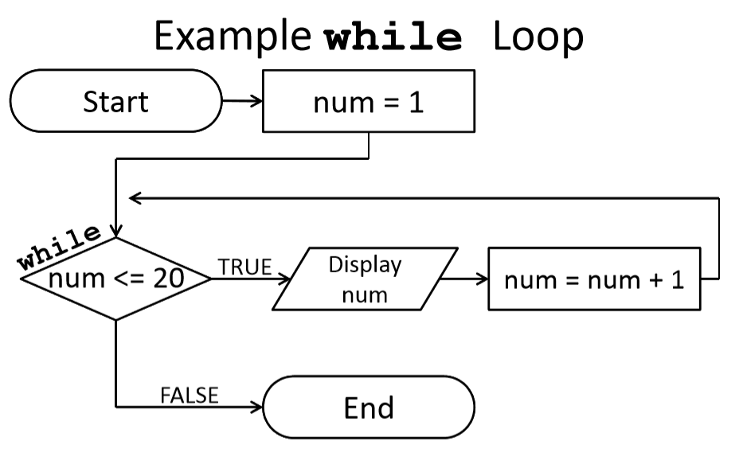

Slide 17
Example Counting while Loops
• By changing a number of factors, you can change how a counting loop behaves
num = 1 # this controls the start
while num <= 20: # this controls the stop
print(num)
num = num + 1 # this controls the update
• How would you count 2, 4, 6, ... 96, 98, 100?
• What about from 10 down to 0?

Slide 18
Calculating while Loops
• For a while loop that needs to calculate something, you must initialize the relevant variable outside of the loop, before it starts variable outside of the loop, before it starts
• For example, if calculating the total of 10 user-provided numbers, initialize a “total” variable before the while loop

Slide 19
Totaling while Loop
• Here is a completed example:
count = 0
total = 0
while count < 10:
num = int(input("Please enter a number: "))
total += num
count += 1
print("The total is", total)

Slide 20
Infinite Loops and Other Problems

Slide 21
Loop Body Not Being Reached
• A while loop’s body may be skipped over entirely
–If the Boolean condition is initially False
militaryTime = 1300
while (militaryTime < 1200):
print("Good morning!")
militaryTime = militaryTime + 100

Slide 22
Infinite Loops
• An infinite loopis a loop that will run forever
–The conditional the loop is based on always evaluates to True, and
never to False
• Why might this happen?
–The loop variable is not updated
–The loop variable is updated wrong
–The loop conditional uses the wrong variable
–The loop conditional checks the wrong thing

Slide 23
Infinite Loop Example #1
• Why doesn’t this loop end? What will fix it?
age = int(input("How old are you? "))
while age < 18: # can't vote until 18 print
print ("You can't vote at age", age)
print("Now you can vote! Yay!")

Slide 24
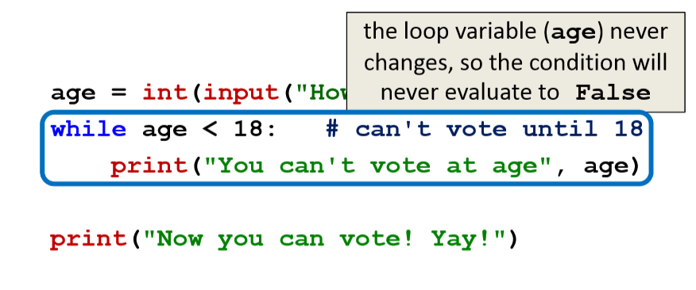
Infinite Loop Example #1
• Why doesn’t this loop end? What will fix it?

Slide 25
Infinite Loop Example #2
• Why doesn’t this loop end? What will fix it?
while True:
# ask user for name
name = input("What is your name? ")
print("Hello", name + "!")

Slide 26
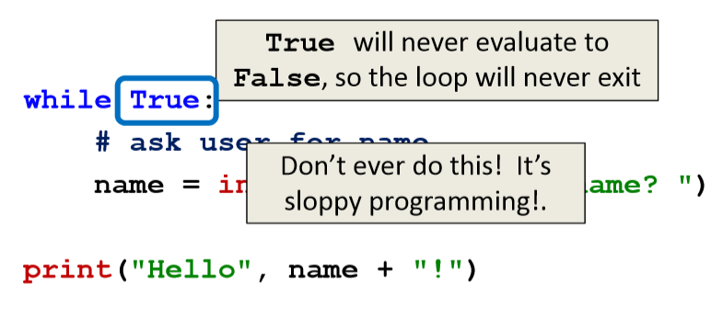
Infinite Loop Example #2
• Why doesn’t this loop end? What will fix it?

Slide 27
Infinite Loop Example #3
• Why doesn’t this loop end? What will fix it?
cookiesLeft = 50
while cookiesLeft > 0:
# eat a cookie
cookiesLeft = cookiesLeft + 1
print("No more cookies!")

Slide 28
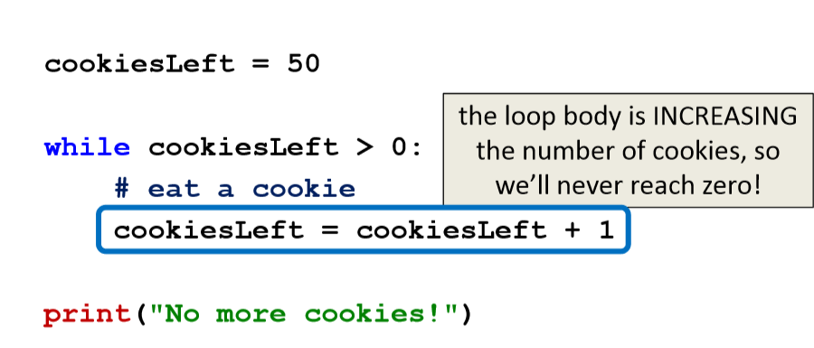
Infinite Loop Example #3
• Why doesn’t this loop end? What will fix it?

Slide 29
Infinite Loop Example #4
• Why doesn’t this loop end? What will fix it?
countdown = 10
print ("Countdown begin...")
while countdown > 0:
print(countdown, "...")
print("Blastoff!")

Slide 30
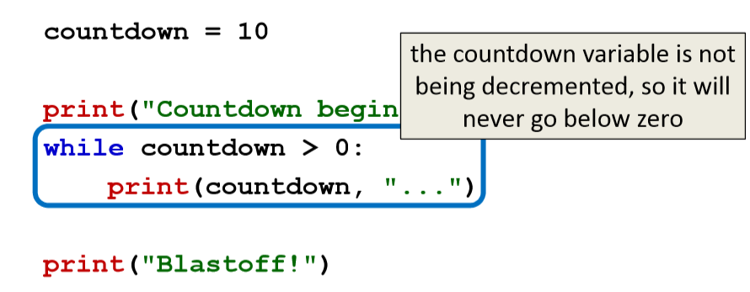
Infinite Loop Example #4
• Why doesn’t this loop end? What will fix it?

Slide 31
Infinite Loop Example #5
• Why doesn’t this loop end? What will fix it?
grade = ""
name = ""
while name != "Hrabowski":
# get the user's grade
grade = input("What is your grade? ")
print("You passed!“)

Slide 32
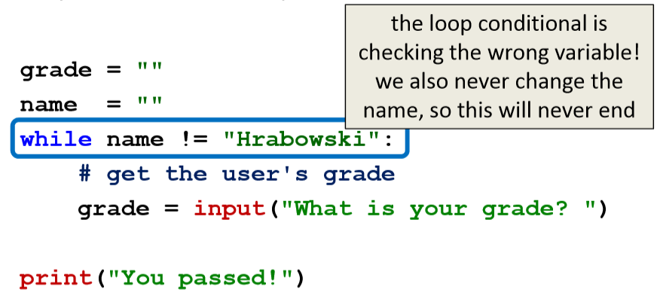
Infinite Loop Example #5
• Why doesn’t this loop end? What will fix it?

Slide 33
Ending an Infinite Loop
• If you run a Python program that contains an infinite loop, it may seem like you’ve lost control of the terminal!
• To regain control, simply type CTRL+C to interrupt the infinite loop –KeyboardInterrupt will be displayed, and you’ll regain control

Slide 34
When to Use while Loops
• while loops are very helpful when you want to get input from the user that meets certain specific conditions
that meets certain specific conditions
–Positive number
–A non-empty string
–A number within a certain range

Slide 35
Example while Loop
• We can use a while loop to get correct input from the user by re-prompting them
num = 0
# so that we can use it here
while num <= 0:
num = int(input("Enter a positive number: "))
# while loop exits because num is positive
print("Thank you. The number you chose is:", num)

Slide 36
Any Questions?

